Slide 1

ROS - ROBOT OPERATION SYSTEM
Samuel Sanchez
Simpi Yadav
Sheng-Hsiang Wang
25 June, 2025

Slide 2
Controlling a vehicle with both MATLAB and Python by using one open-source system.
Would you try it?

Slide 3
ROS2

Slide 4
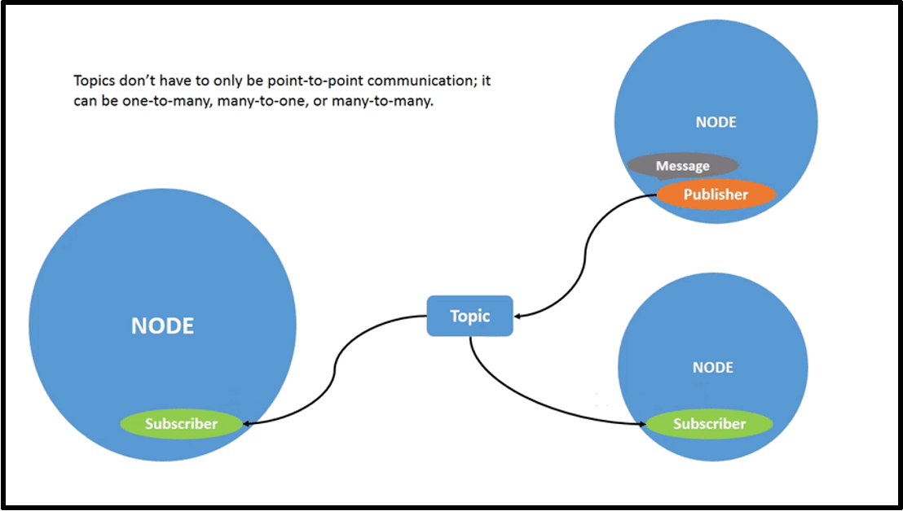

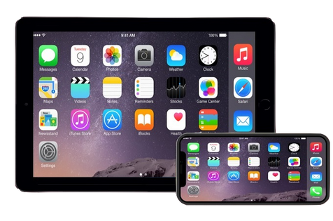


What is ROS2?
ROS 2 is an open-source platform that enables different components of a robot to communicate and work together.
YouTuber
Channel
Audience
Audience

Slide 5
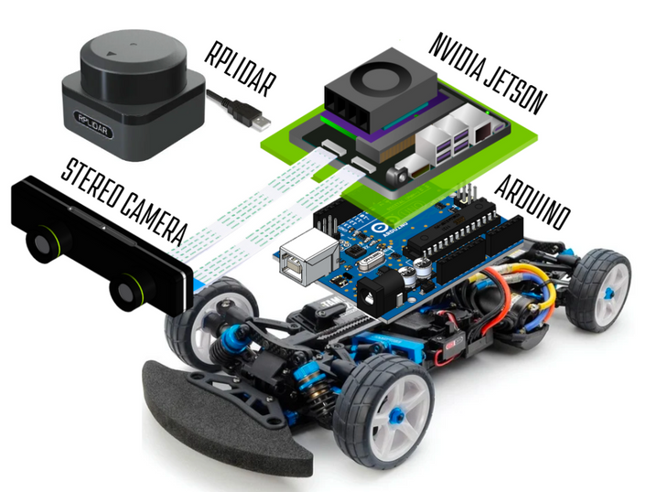
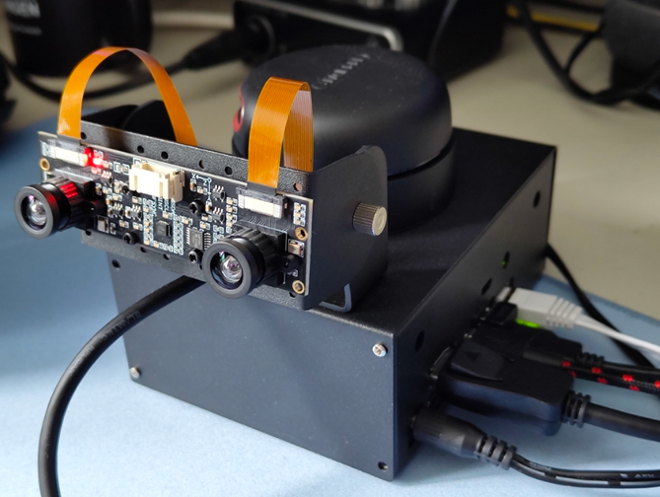
Implementation
Hardware Setup
Stereo camera setup with dual IMX219 camera module and RPLiDAR A2 sensor
ROS2 Environment
MATLAB or Python

Slide 6
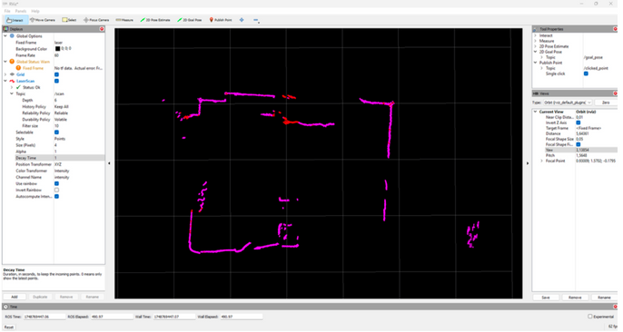
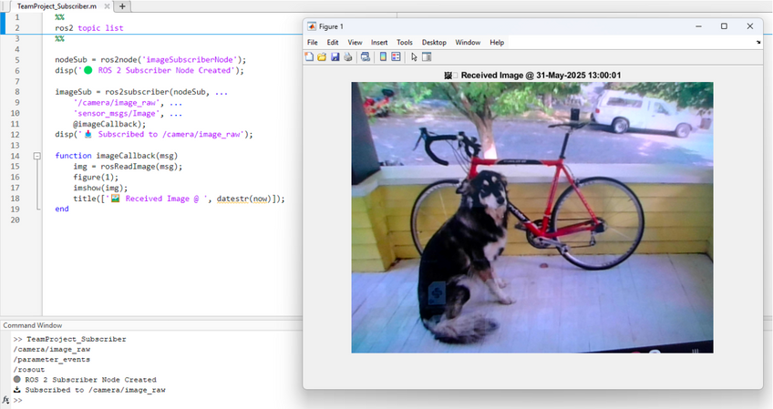
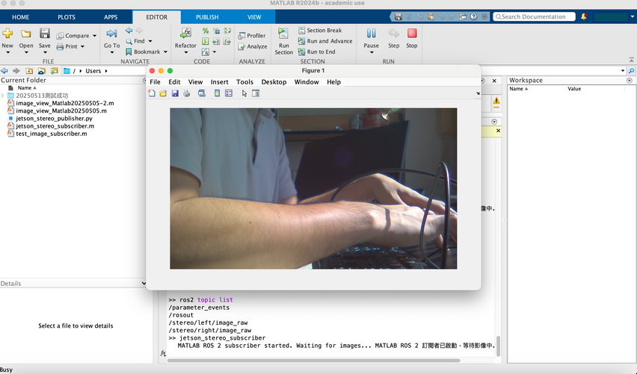
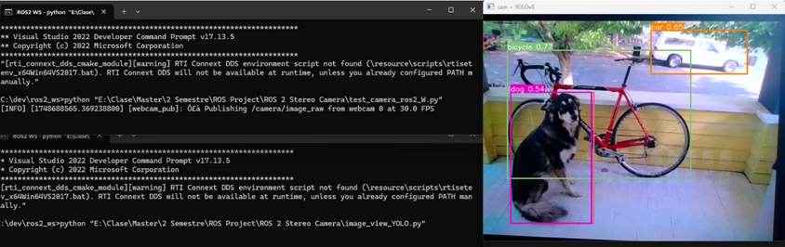
Experiments and Results
LiDAR Data Acquisition
Stereo Camera Image Reception on different platform

Slide 7



Project Objectives
Analysis Phase
Strategy Development
Analyze sales performance, market trends, and consumer behavior.
Conduct a SWOT analysis of existing sales strategy.
Create new strategies using marketing, sales promotions,
Customer engagement to leverage strengths and opportunities.
Implementation Plan
Create a timeline with milestones
And responsibilities. Set KPIs to measure success.

Slide 8

Expected Outcomes
Increased Sales Figures:
Target a 25% increase in sales over the next years.
Measure success by tracking sales metrics and revenue growth.
Improved Customer Engagement:
Foster stronger relationships with customers through personalized engagement strategies.
Increase customer retention rates and loyalty.
Enhanced Market Reach:
Expand market reach by tapping into new demographics or geographical regions.
Strengthen brand presence through effective marketing campaigns.

Slide 9

Methodology
Data Collection:
Gather sales data, market research, and consumer feedback through surveys and analysis tools.
Utilize both primary and secondary research methods to gather comprehensive insights.
Brainstorming Sessions:
Collaborate to generate innovative ideas for product positioning, pricing, and promotional campaigns.
Consider various channels such as online platforms, partnerships, and offline marketing.
Testing and Refinement:
Pilot the proposed strategies on a smaller scale to assess their effectiveness.
Gather feedback, iterate, and refine the strategies based on initial results.

Slide 10
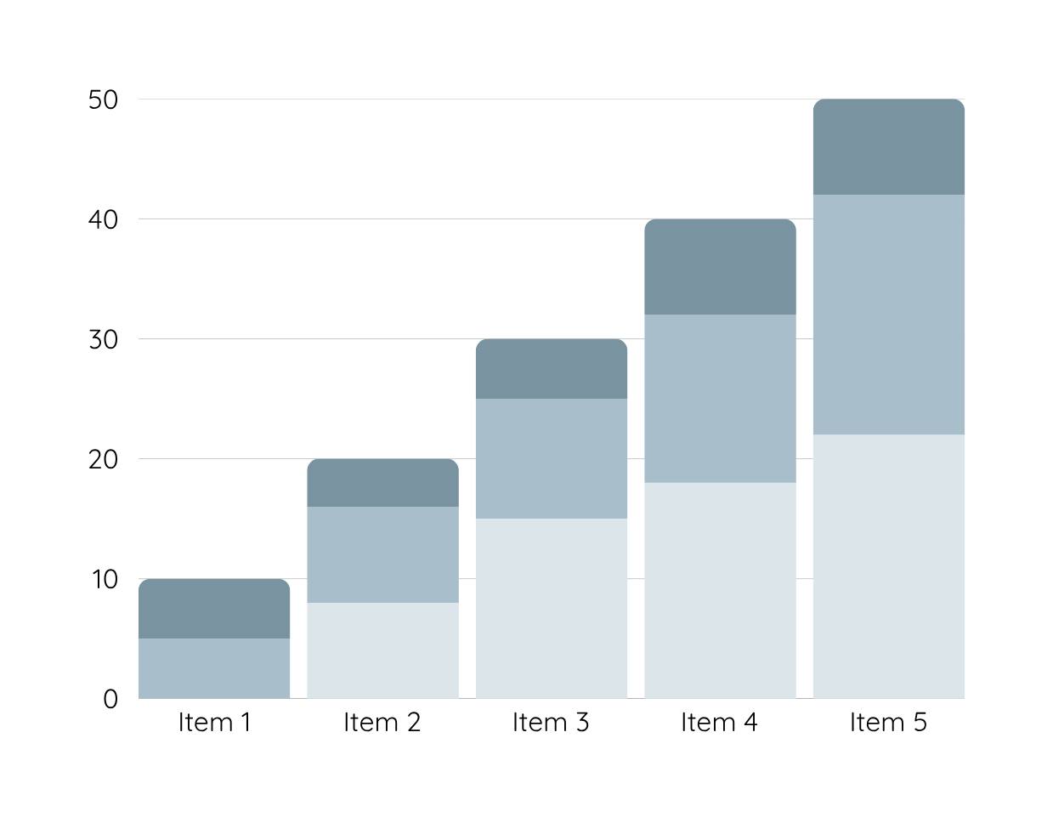
Data Analysis
Over the past year, sales for Warner & Spencer have experienced a consistent decline, dropping month-on-month. The graphical representation of sales volumes reveals a noticeable downward trend, especially in the last quarter.
Product 1
Product 2
Product 3

Slide 11
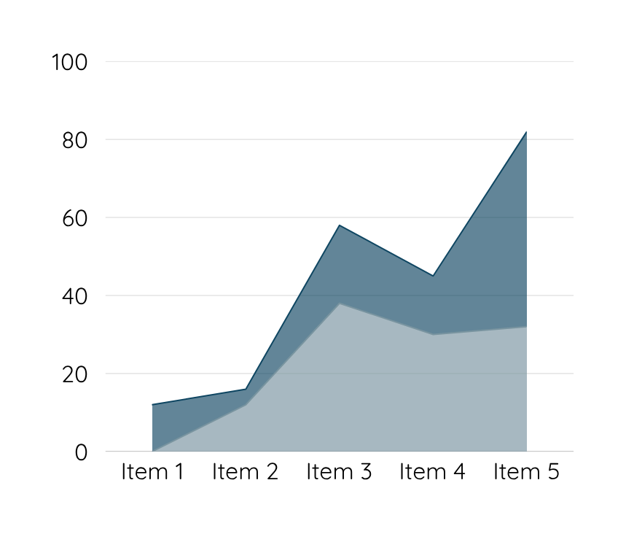
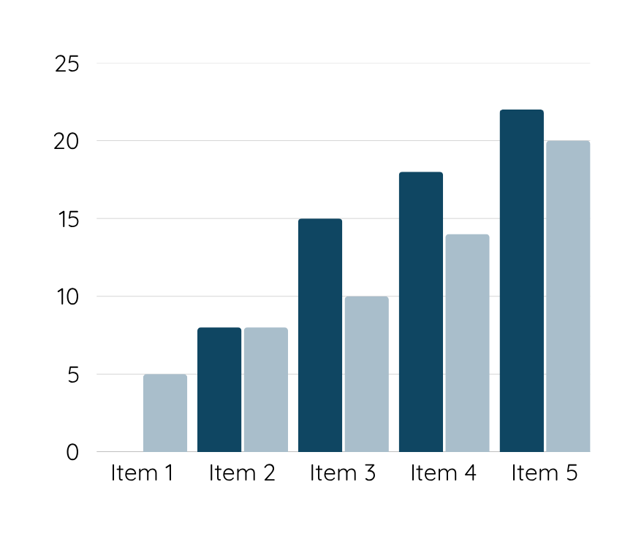
Data Analysis
Customers are unhappy with Warner & Spencer's new packaging, which may be contributing to a decline in sales. Competitors offer better features and pricing, making it difficult for our product to stand out in the market.

Slide 12
Conclusion
By implementing a well-researched and innovative sales strategy, our goal is not only to boost immediate sales figures but also to establish a sustainable framework for continued growth and success.

Slide 13
Thank you

